Slide 1
Edge Fundamentals Bootcamp
What is a Proxy ?

Slide 2
What is a Proxy ?
“a proxy is a computer system or an application that acts as an intermediary for requests from clients seeking resources from other servers”
For more info, see https://en.wikipedia.org/wiki/Proxy_server
Notes:
https://en.wikipedia.org/wiki/Proxy_server

Slide 3
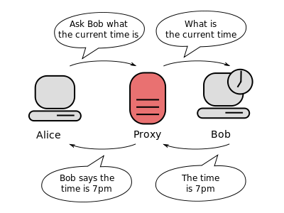
Proxy
Communication between two computers (shown in grey) connected through a third computer (shown in red) acting as a proxy. Bob does not know to whom the information is going, which is why proxies can be used to protect privacy.
Notes:
A client connects to the proxy server requesting some service such as a file, connection, web page, or other resource available from a different server and the proxy server evaluates the request as a way to simplify and control its complexity
Proxies were invented to add structure and encapsulation to distributed systems. Today, most proxies are web proxies, facilitating access to content on the World Wide Web
It acts as a facade layer between the client and resource server

Slide 4
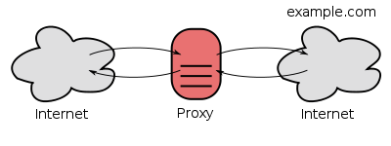
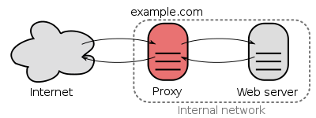
Common Proxy Types
Open Proxy
An open proxy forwarding requests from and to anywhere on the Internet.
Reverse Proxy
A reverse proxy taking requests from the Internet and forwarding them to servers in an internal network. Those making requests connect to the proxy and may not be aware of the internal network.
Notes:
https://en.wikipedia.org/wiki/Proxy_server
A proxy server that passes requests and responses unmodified is usually called a gateway or sometimes a tunneling proxy.

Slide 5
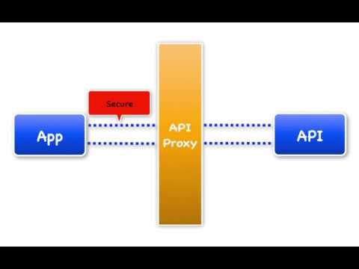
API Proxy in Edge
Notes:
Within the domain of Edge, an API Proxy is something that acts as a substitute for the actual API implementation, sometimes called a backend.
Instead of clients directly connecting to a backend API, a client will connect to an API Proxy that runs in Edge, and Edge will connect to the backend API.
API proxies decouple the app-facing API from your backend services, shielding those apps from backend code changes.
As you make backend changes to your services, apps continue to call the same API without any interruption.
http://docs.apigee.com/api-services/content/understanding-apis-and-api-proxies

Slide 6
API Proxy in Edge
Why Proxy? The proxy obviously adds an extra layer, an extra network hop! Then why do it?
By adding this layer,
you gain a level of control and insight into the inbound API requests.
verify security tokens
collect analytics information
serve requests from cache
perform traffic management
you gain insight into the API usage.
you decouple the developer-facing API from the API exposed by backend services.
it shields "consumer developers"
it enables the API Provider, to innovate at the edge without impacting internal applications
it acts as a service virtualization layer
introduce new services that compose multiple backend services.

Slide 7
In short….
API Proxy translates to API Management

Slide 8
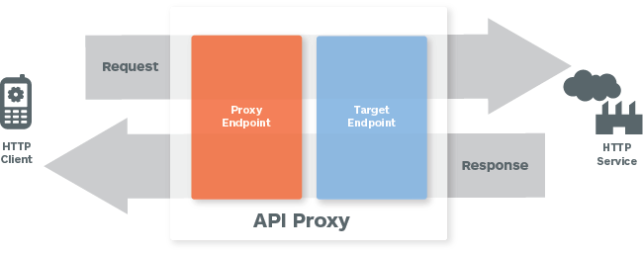
How an API Proxy works in Edge?
Proxy Endpoint
This is the inbound request
Configured to define the URL of your API proxy.
Policies attached are to enforce security, quota checks, and other types of access control and rate-limiting
Target Endpoint
This is the outbound request
Configured to forward requests to the proper backend service, including defining any security settings, protocol, and other connection information
Policies attached are to ensure that response messages are properly formatted for the app that made the initial request.

Slide 9
THANK YOU

